Slide 1
Magnetism
Very hard and spoopy I’m sorry

Slide 2
Quick electricity topic

Slide 3
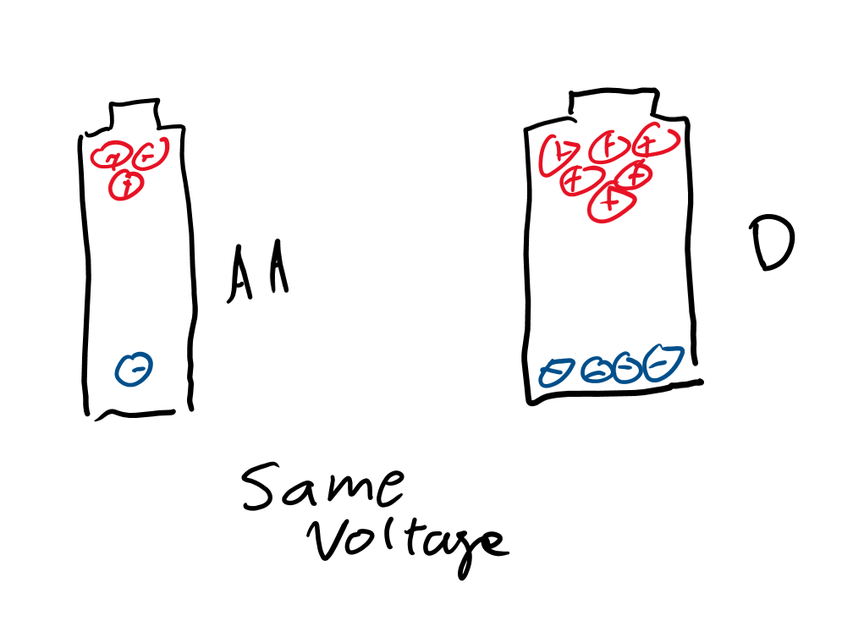
Voltage
What was electric potential?
Voltage is the difference in electric potential.

Slide 4
Magnetic particles?

Slide 5
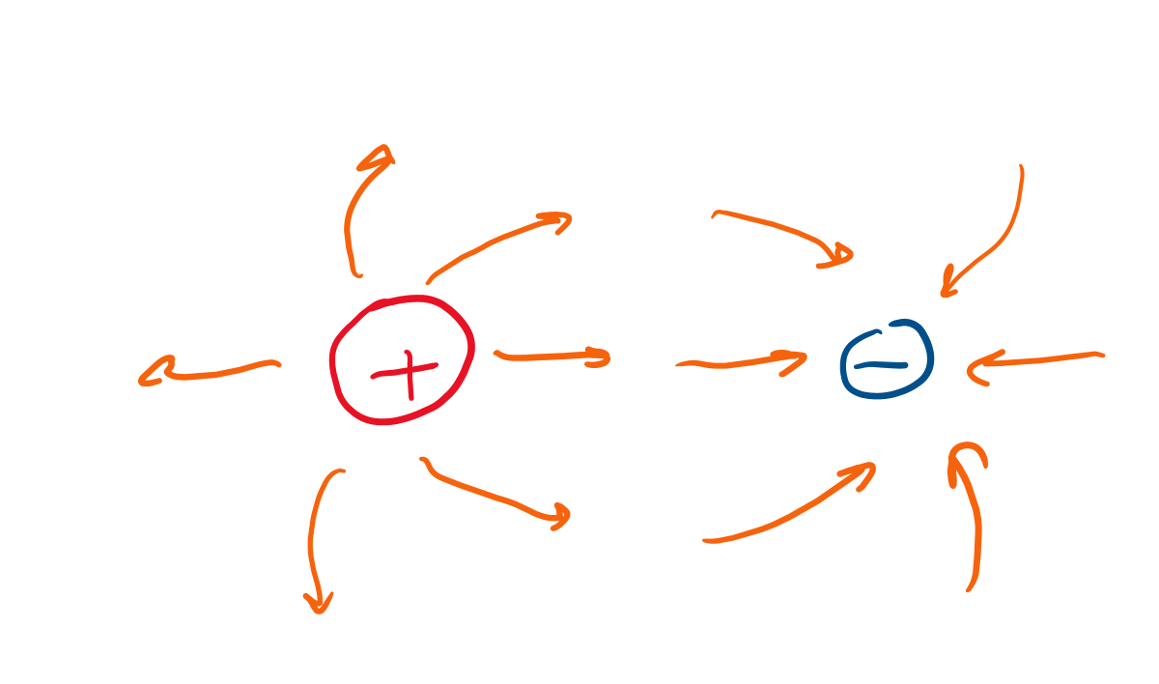
For electricity what particles carry charge?
What carries positive charge?
Negative charge?

Slide 6
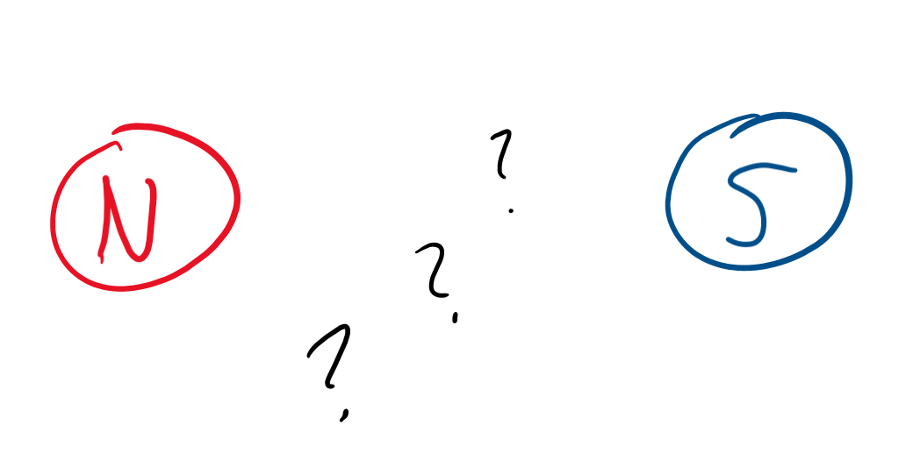
What carries it for magnets?
What is the name for “charge” but for magnets?
What particles would carry this “magnetic charge”?

Slide 7
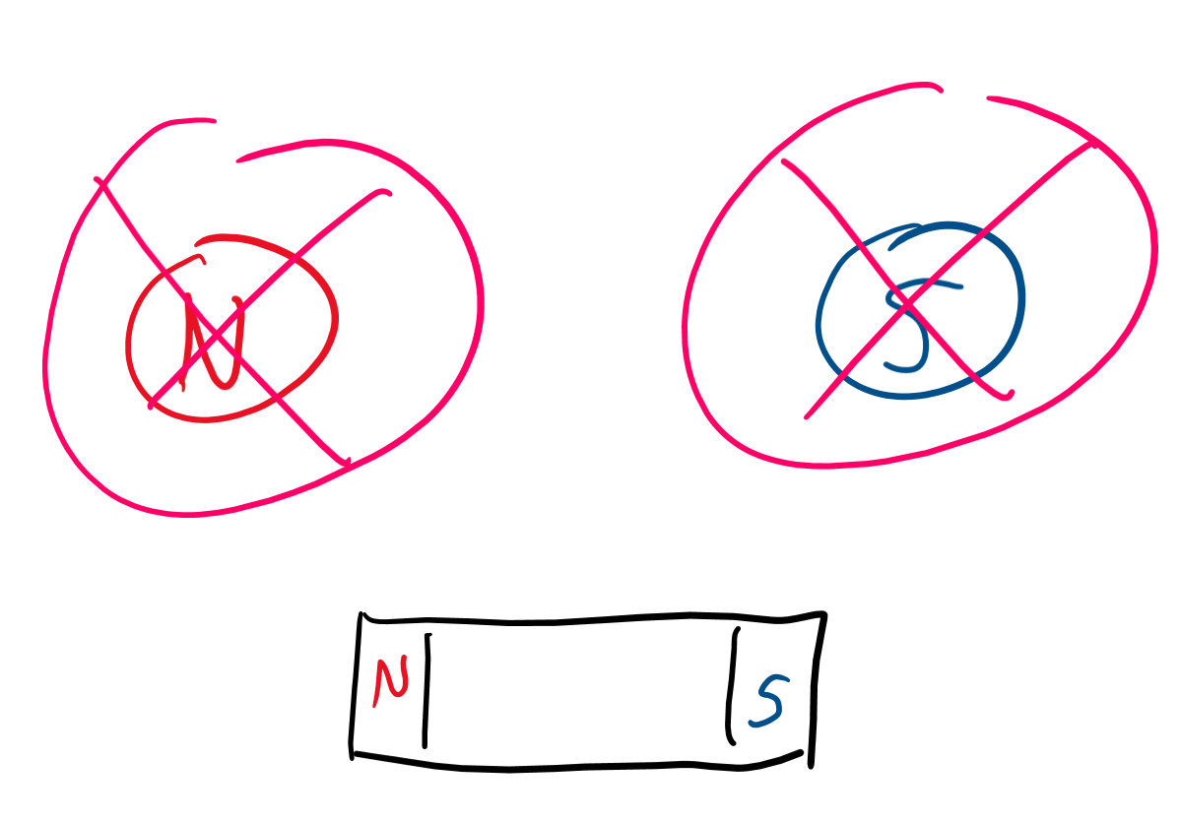
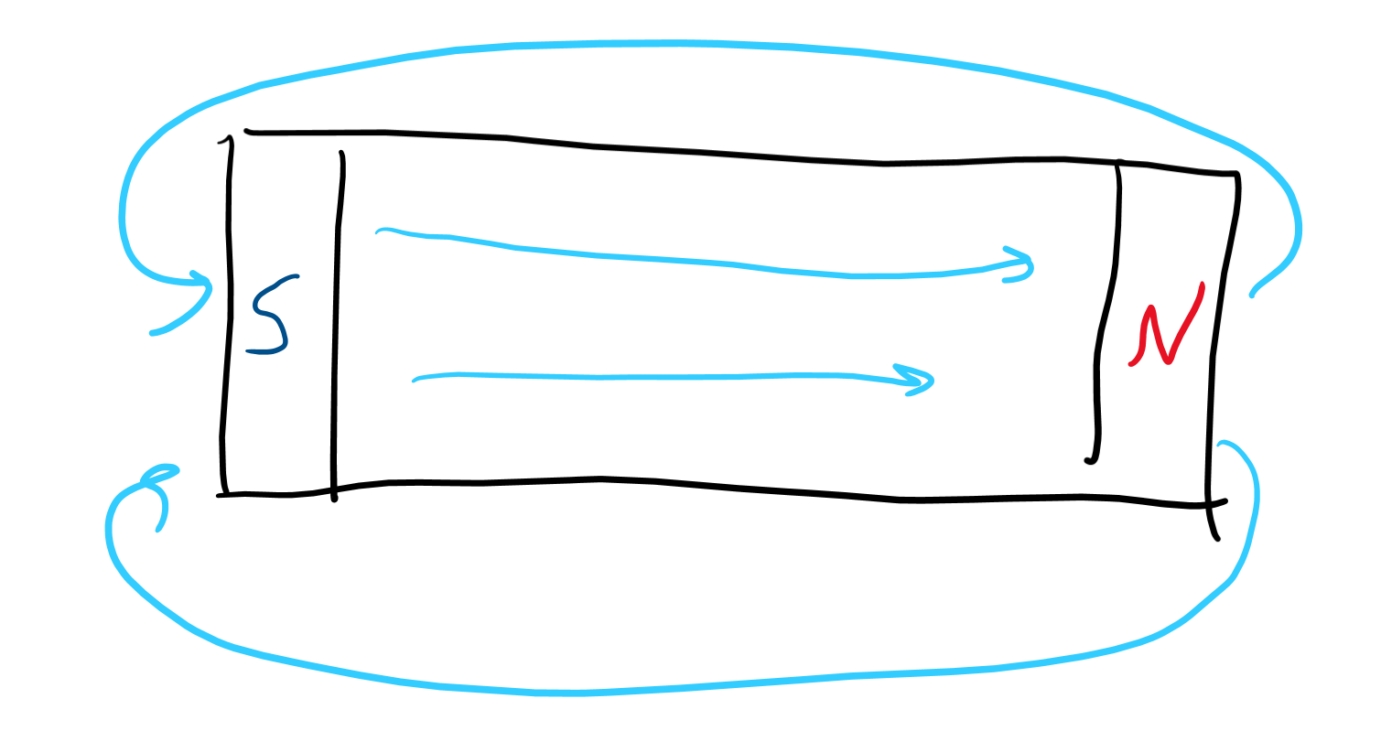
Magnetic particle?
Actually doesn’t exist!
Magnetism is fake confirmed you can all head home now class is over.

Slide 8
Induction

Slide 9
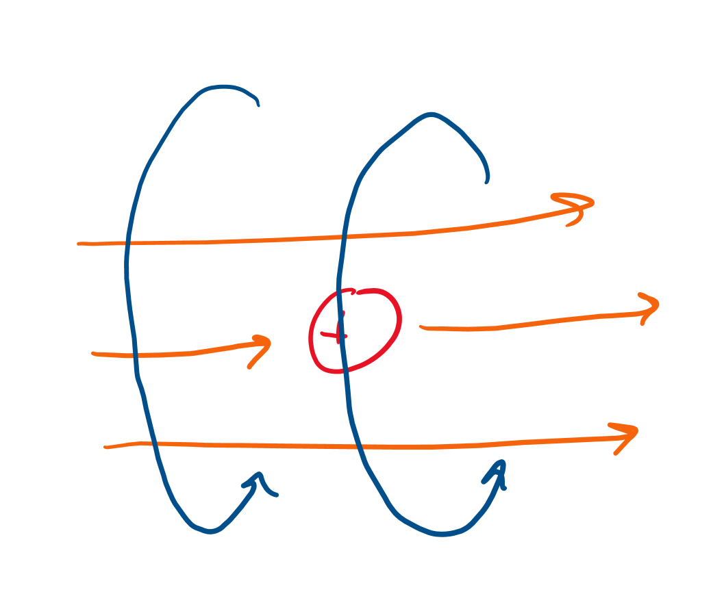
Maxwell-Faraday
These scientists were just like okay but like magnets do exist so how do magnetic fields come about?
Moving electrical charges!
When we have a current, we also have a magnetic field.

Slide 10
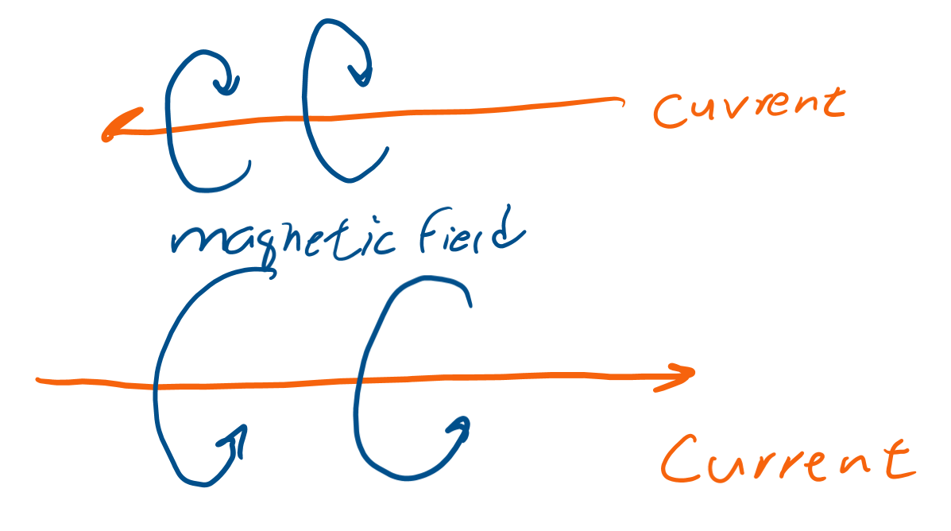
Remember torque?
No? Well uhh. . . it’s important here.
If we spin a top, we can “curl” our fingers on our right hand in the direction of motion, and our thumb will point toward the direction of torque.
If we point our thumb at current, we get magnetic field as the direction of our fingers.

Slide 11
Magnetic field

Slide 12
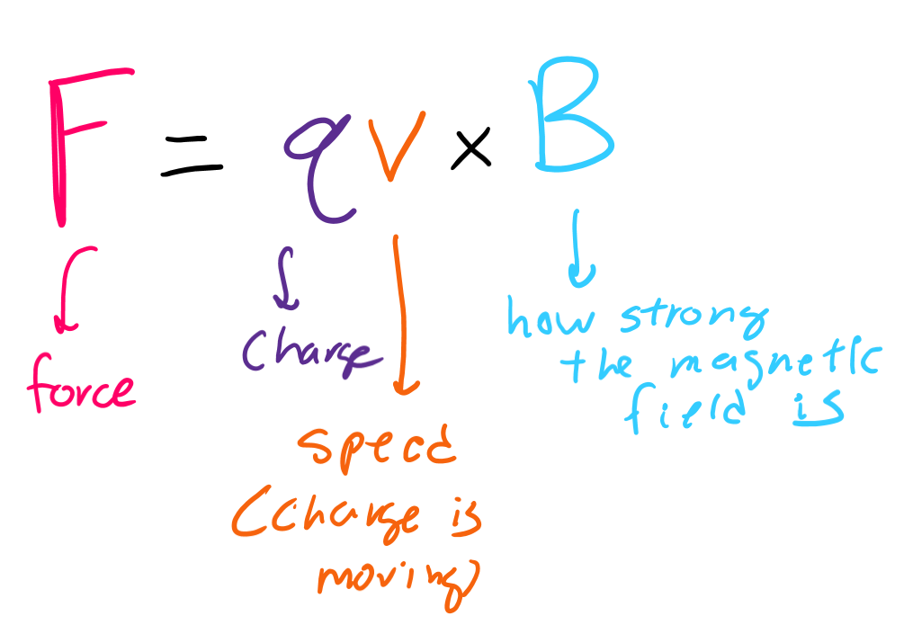
Magnetic “force” is more like torque
Electric force was just Eq (electric field strength times the strength of the charge), kinda like F = ma.
Magnetic force is a bit more. . . sus.
You’d think, oh, it’s just F = Bq, but no.
Magnetic fields only act on moving charges, so it’s actually F = Bqv (fancy math way is F = qv x B).

Slide 13
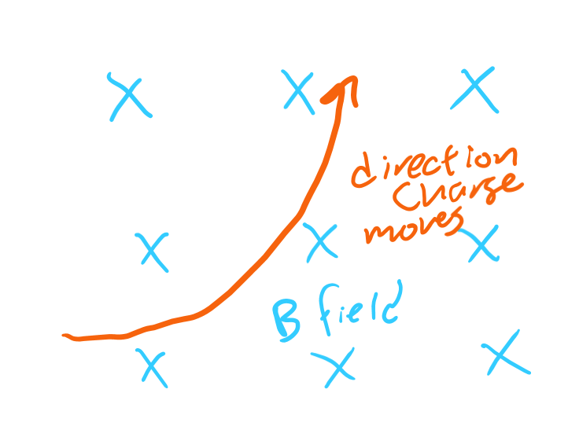
What does that do to a charge?
It makes it go in a circle, kinda like a merry go around!

Slide 14
Very spoopy stuff

Slide 15
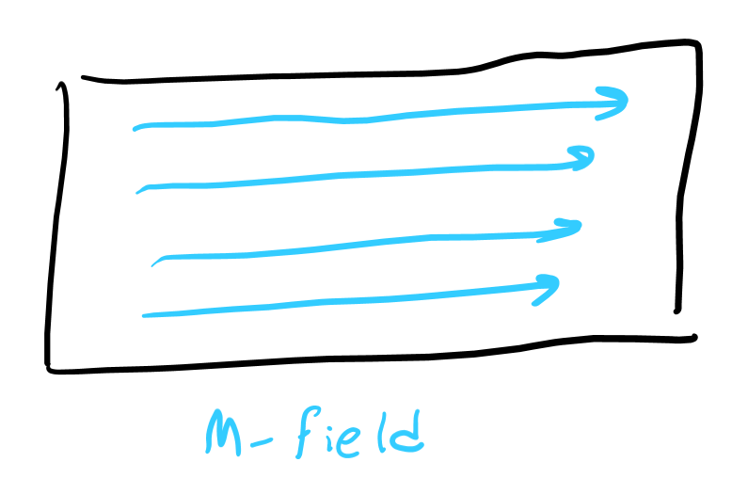
Field M
This is called “magnetization.”
Results from the particles themselves.
Each atom contributes to the “M” field.

Slide 16
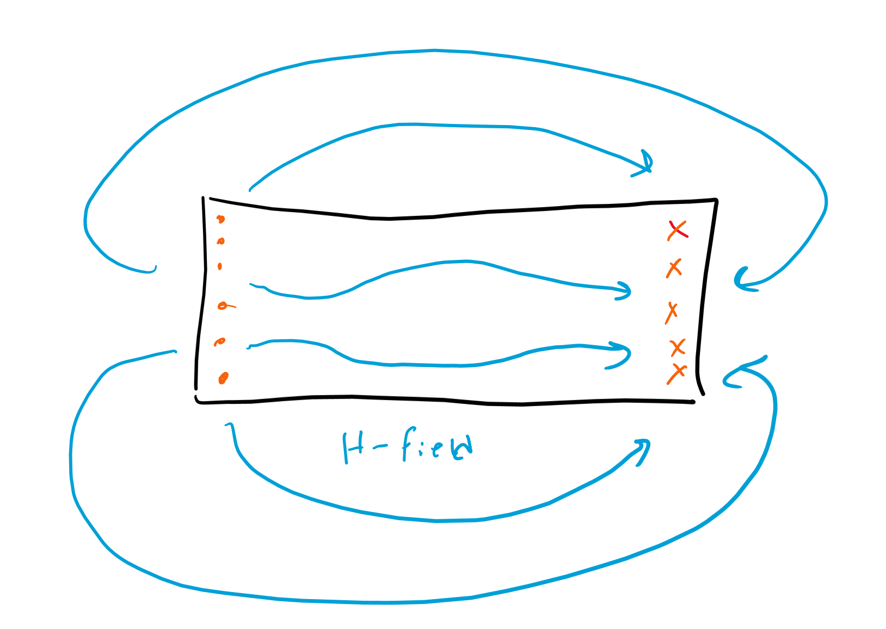
Field H
The M field induces a current, which causes an external field, the H field.
Also called “magnetic field strength.”

Slide 17
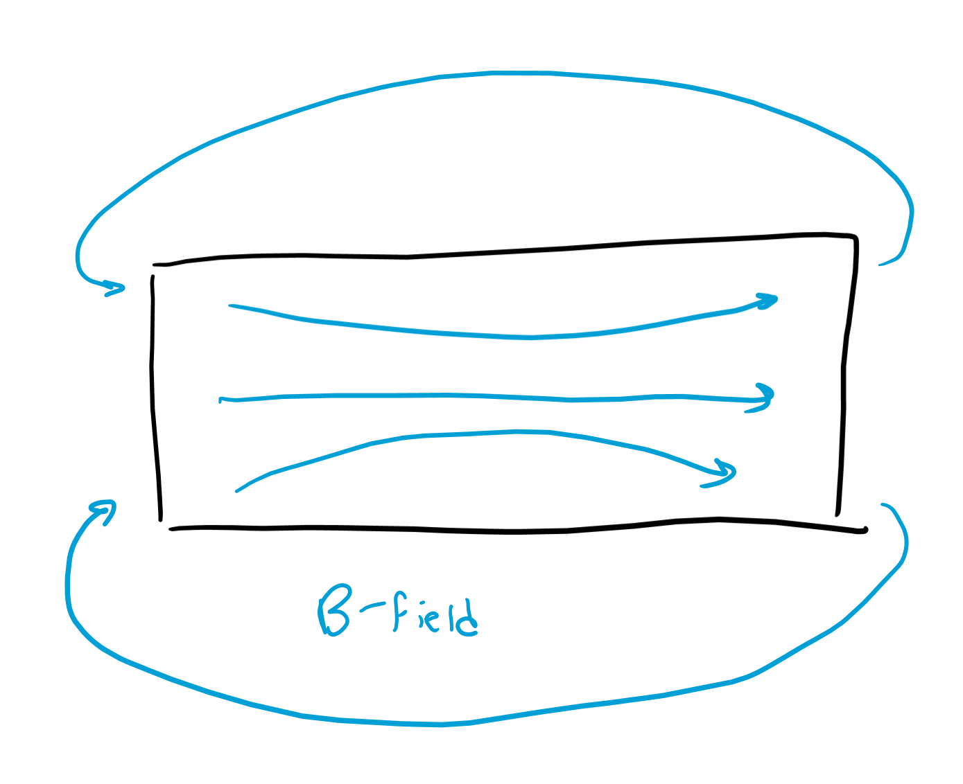
Field B
This is what people usually talk about with magnetic fields; it’s the combination of both H and M field.
Also called “magnetic flux density” because they needed a sciency-sounding name.

